Slide 1
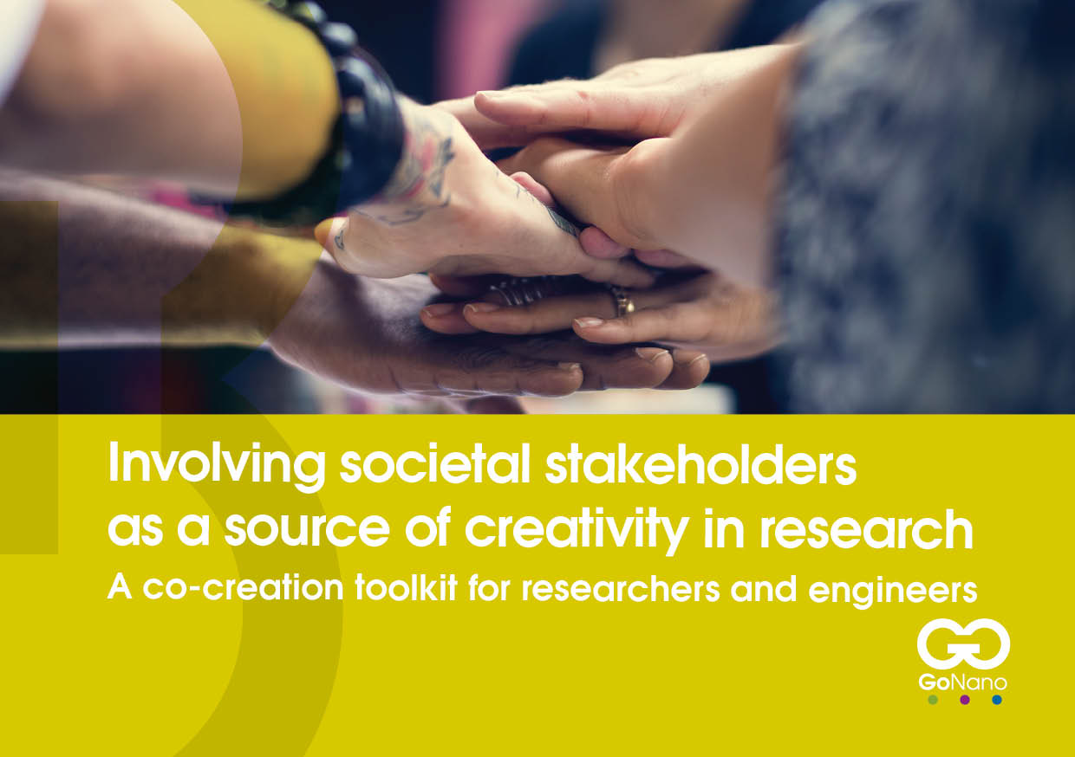
GoNano is a Coordination and Support Action funded by the European Union under the NMBP Programme of Horizon 2020, Grant Agreement n° 768622.

Slide 2
Introduction
GoNano aimed to explore how researchers can work with publics and professional stakeholders across Europe to align future nanotechnologies with societal needs and concerns.
Co-creation can be understood as the collaborative development of new value. It is a form of collaborative innovation: ideas are shared and improved together.

Slide 3
Why use this toolkit?
  To share our lessons learned
  To support researchers and engineers who
  would like to co-create with citizens and
  societal stakeholders
By offering this six-step approach to co-creation, we hope to inspire researchers and engineers to continue this journey, working together with citizens and societal stakeholders to create value in new settings, with new topics and with creative outcomes.

Slide 4
Six steps
Define your goal
Identify the stakeholders
Start planning
Organize your co-creation event
Evaluate and reflect on the process
Share the results

Slide 5
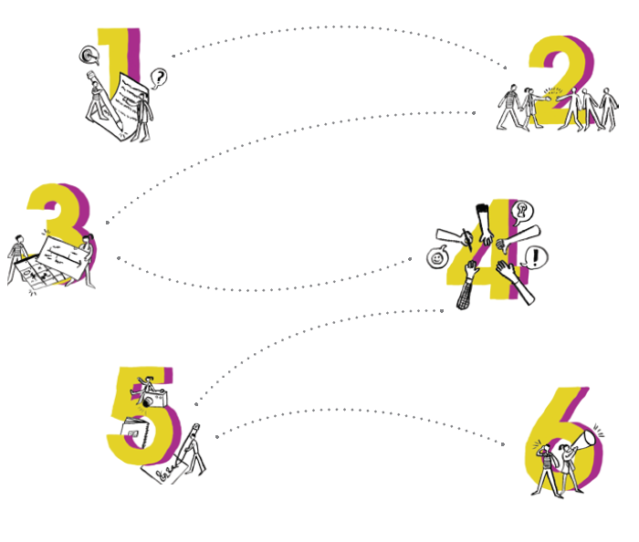

Six steps
Each step is supported by:
  Tip or advice based GoNano experiences,
  Example or exercise to help you visualize and guide you through the step.
Co-creation is an iterative process: this means that you may need to move back and forth between each of the consecutive steps and cycle through the process several times

Slide 6
Enabling co-creation: terms of engagement
The following criteria should be taken into account when designing a co-creation event:
  The purpose of the initiative should be made clear to all participants
  Defining what is at stake is key
  Discussions should be specific enough to affect the decisions of actors
  The process of what happens with the input should be transparent
Get the ground rules for discussion in place
  Symmetry of ignorance: we are all expert in some fields, but laypersons in most others. In other words, all participants are equal and have something unique to bring to the table.

Slide 7

Define your goal

Slide 8
Define your goal
Answer the following questions:
  What is your motivation and expectation of the co-creation process?
  What is the problem you want to solve?
  Why do you want to engage stakeholders in your research?
  What do you expect to get out of it?
  Prepare a 60-second pitch about your research topic. Describe your research in lay words to a non-expert audience. Try to avoid technical words. Why does your research matter? What problem does it aim to solve? And why do you need help from your audience to address this problem?
Pitch with different stakeholders in mind. Experience how it changes the language and focus.

Slide 9
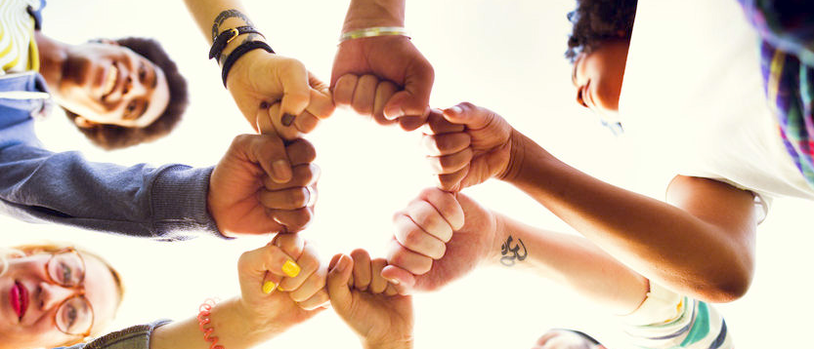
Identify the stakeholders

Slide 10
Identify the stakeholders
Identify your stakeholders (customers, private actors, knowledge institutes, NGOs) and their motivation
Identify shared goal that drives collaboration between the stakeholders
  Draft your ideal participant list. Start by making a list of key stakeholders to achieve your goal or solve your problem.
  When inviting citizens, to give them a voice, they should be facilitated to have a genuine influence on something that is important to them.

Slide 11
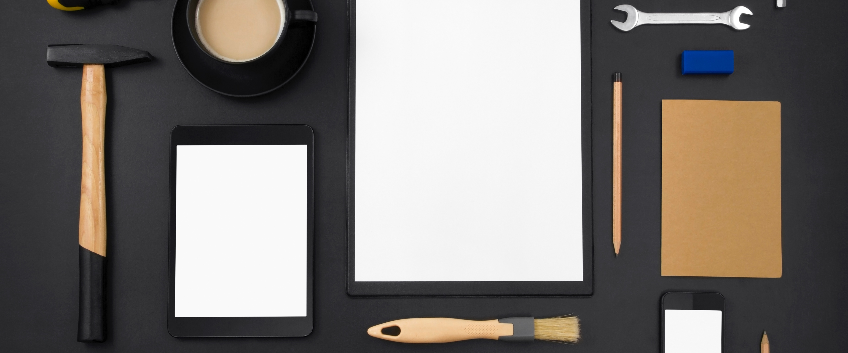
Start planning

Slide 12
Start planning
Design your strategic canvas
  Stakeholder: map the stakeholders you want to invite
  Results: define what you want to get out of the event
  Ethical, legal and social issues: define what issues you want to address
  Milestones: what are the due dates to accomplish major tasks?
  Critical success factors: what specific dynamics of stakeholder sectors should you be aware of?
  Risks and contingencies: what circumstances could stand in the way of the successful completion of the event? What are possible risk-mitigation measures?
Design your practical canvas
  Team: build and organising team
  Resources: think about financial, political and social resources
  Venue: find the right place for your event
  Tools for co-creation: prepare tools and material
  Time schedule: start a planning from start to finish

Slide 13
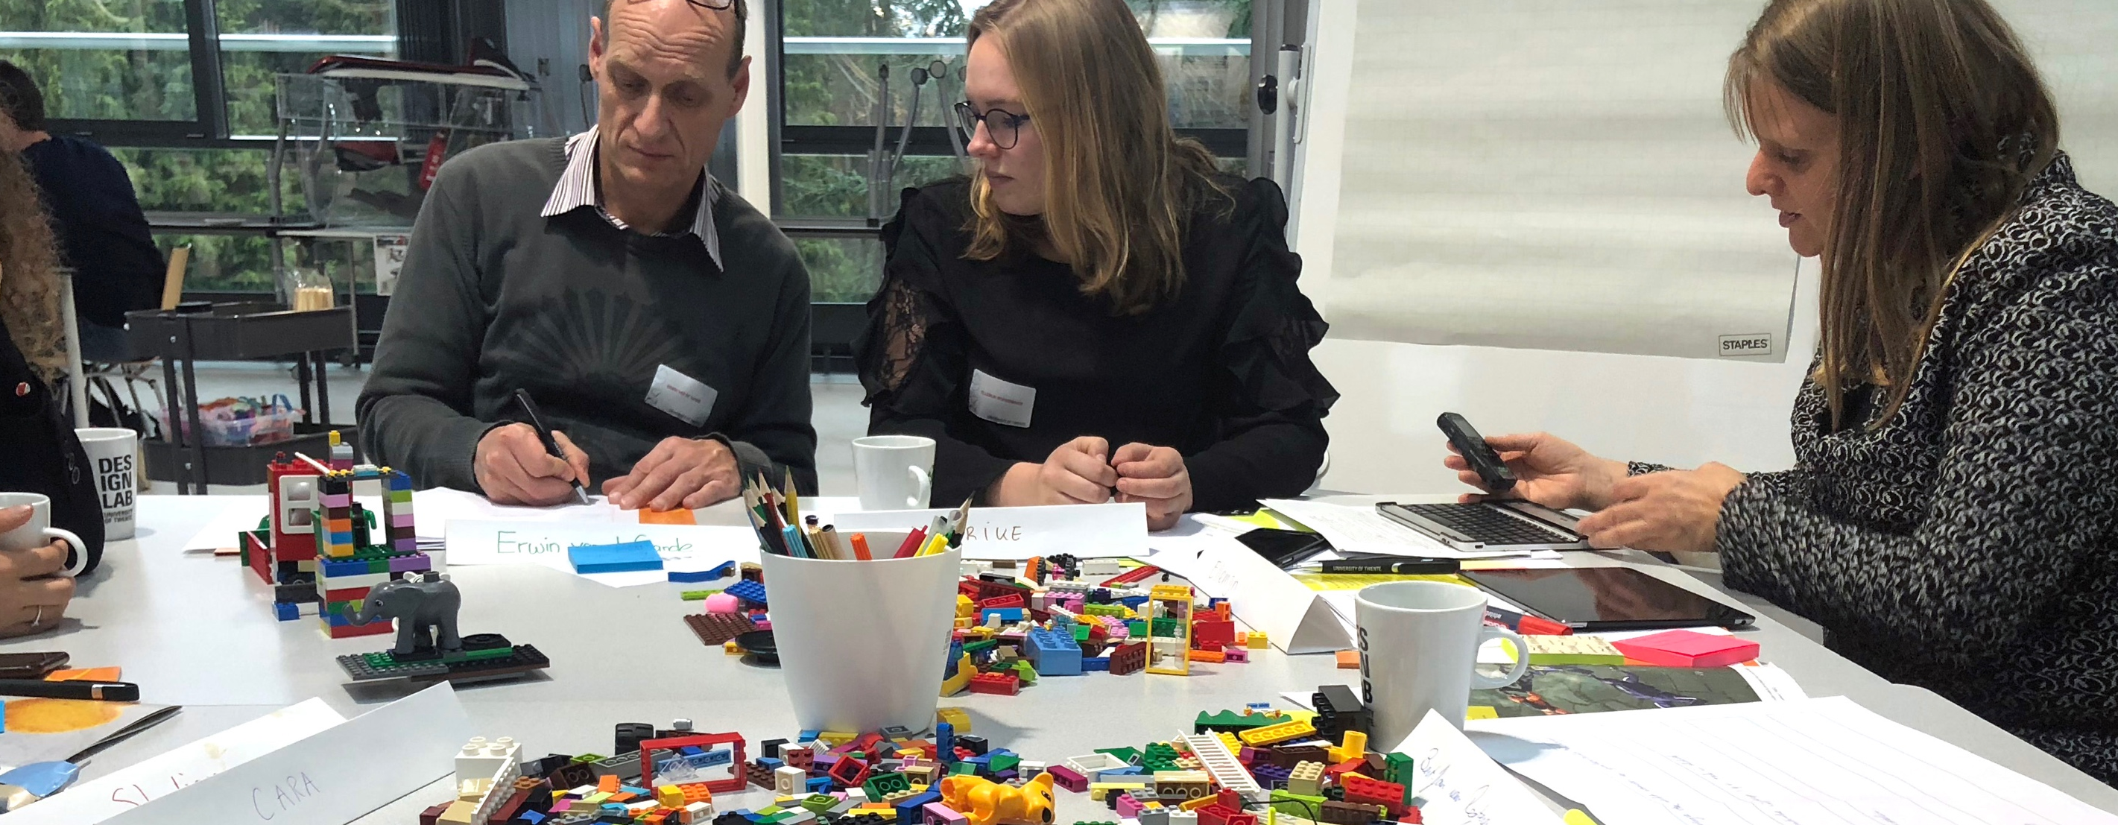
Organise your co-creation event

Slide 14
Organise your co-creation event
Get familiar with the co-creation steps
  Exploration: Participants get to know each other and share their wishes, needs and values. The key is to together understand the problem and open up and empathize with the problem
  Ideation: Imagine and co-create responses to these wishes, needs and values, building on the varied expertise around the table.
  Prototyping: Generate an action plan that visualizes in discrete steps how the wishes, needs and values will be integrated in product suggestions
  Reflection: Consider broader reflective questions about the feasibility of the action plan and the overall outcomes.
Select and prepare tools to support these steps
  GoNano insights: co-creation sessions with citizens and stakeholders. Watch these video clips from GoNano experiences. What would you do differently?

Slide 15
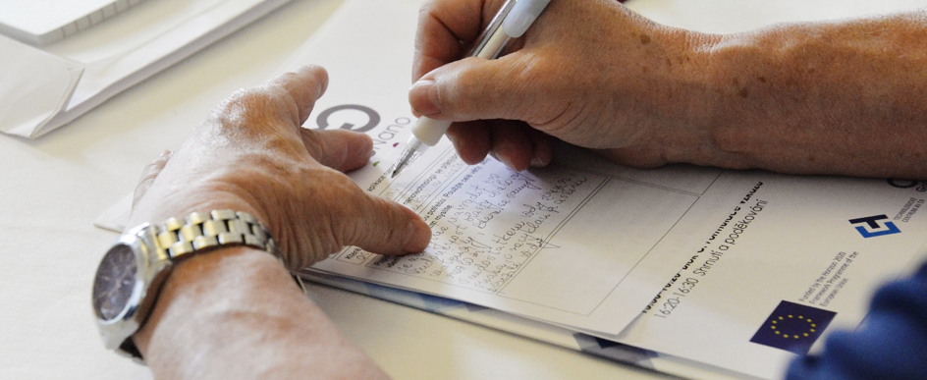
Evaluate and reflect on the process

Slide 16
Evaluate and reflect on the process
Prepare an evaluation moment for yourself
  Did you achieve your goal? Were you able to co-create solutions to the problems that you identified? Do the results match your initial assumptions? What went well? What could have been better? Analyse all successes and failures.
Prepare an evaluation moment for your participants
  Did their experiences match their expectations (process, content)? What have they learned? Do they want to stay informed?
  GoNano used an online questionnaire and conducted follow-up interviews

Slide 17
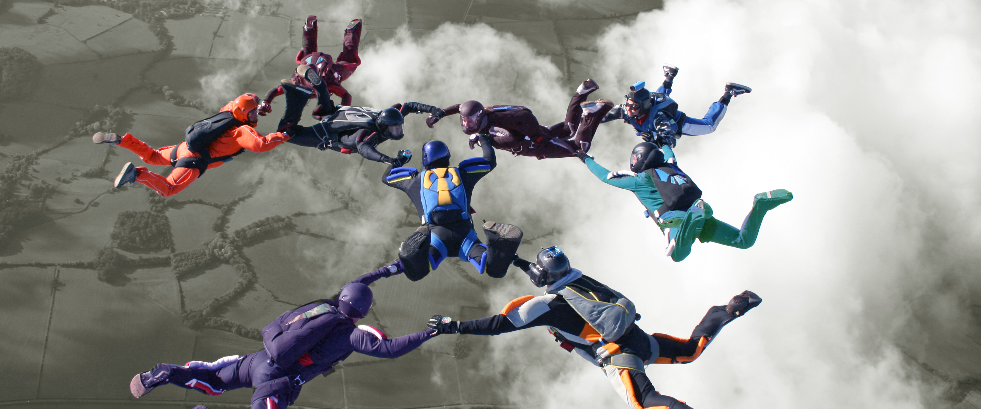
Share the results

Slide 18
Share the results
Make a communication, dissemination and exploitation plan
  It is essential to keep your collaborators engaged, to invite others to join the co-creation process and to share the process and its outcomes with wider audiences.
  Think about the target groups you’re trying to reach, through which channels you can reach them and how you can interest them in the project and its results.
  Use differechnt annels to share your results; websites, social media or newsletters, but also face-to-face meetings at conferences and networking events.
  Collect images, quotes and insights in each co-creation phase and share and communicate results continuously throughout the process.
  When sharing your results always comply with the General Data Protection Regulation (GDPR): make sure that you have the permission of all participants to use their personal information (names, photos, affiliation, etc.).
  Use hashtags (#co-creation, #RRI), tag others and add visual content to increase your visibility on social media.

Slide 19




Good luck and don’t forget keep on trying
www.gonano-project.eu
Also check our website for
- Brochure with more information
- Poster with highlights to show your colleagues
- GoNano website with tools, examples, video clips ...
Find us on
GoNano is a Coordination and Support Action funded by the European Union under the NMBP Programme of Horizon 2020, Grant Agreement n° 768622.

